Slide 1

Learning Symbolic Task Decompositions for Multi-Agent Teams
Ameesh Shah, Niklas Lauffer, Thomas Chen, Nikhil Pitta, Sanjit A. Seshia
Presented by Zi-Long Wang
2025-2-28

Slide 2



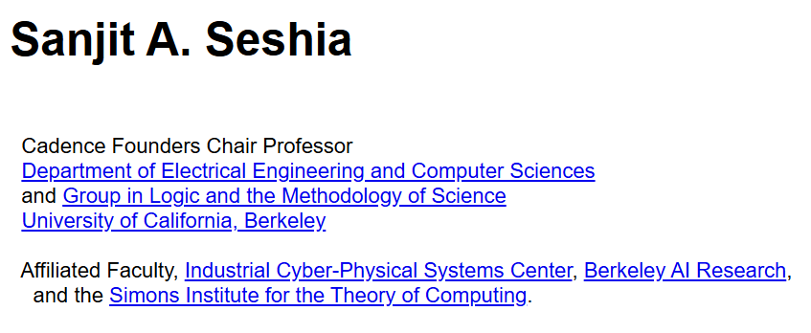
Authors
Ameesh Shah
UC Berkeley
ameesh@berkeley.edu
machine learning and formal methods,with particular focus on applications in robotics, autonomy, and program synthesis.
Niklas Lauffer
UC Berkeley
nlauffer@berkeley.edu
human-AI cooperation, multiagent systems, and AI safety.

Slide 3
Background

Slide 4
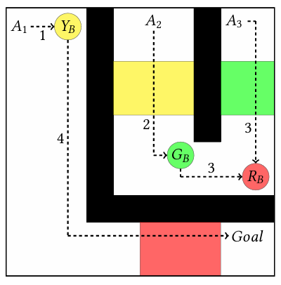
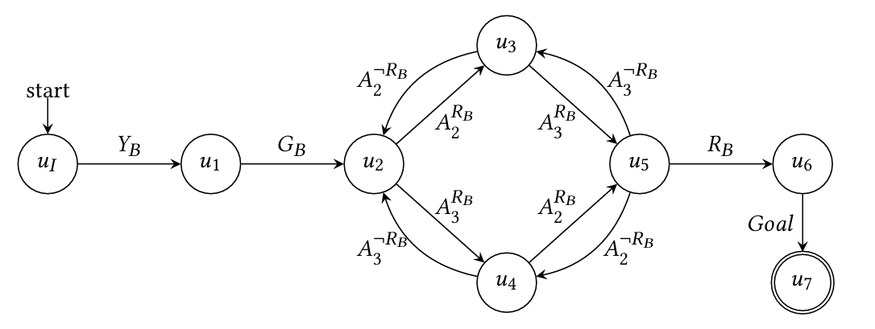
Reward Machine and sub-task RM
Cooperative buttons domain
Reward machine encoding the cooperative buttons task
Event set:

Slide 5
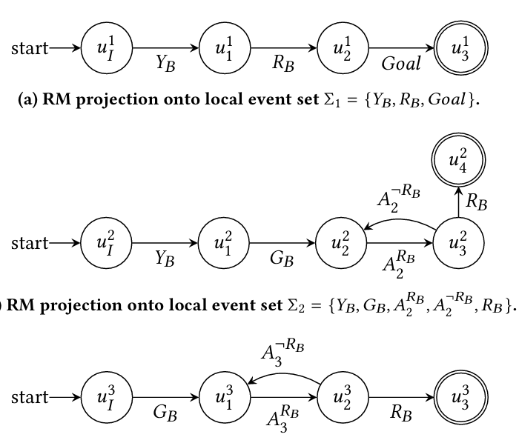
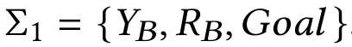
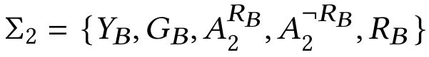
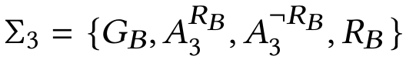
Reward Machine and sub-task RM
Original RM
Event set:
sub-task RM
Local event set:

Slide 6
LOTaD: Learning Optimal Task Decompositions for Multiagent Reinforcement Learning

Slide 7
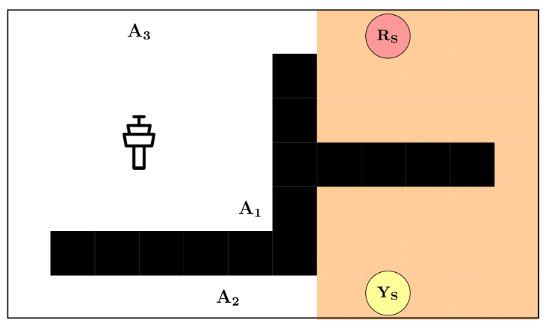

Problem Setting
First, any two agents must meet at headquarters(HQ) X to send the signal.
Next, the agent must visit locations Rs and Ys in any order.
There exists a hazardous region, encoded in orange, that prevents more than one agent from entering the region at a time.
Repairs domain

Slide 8
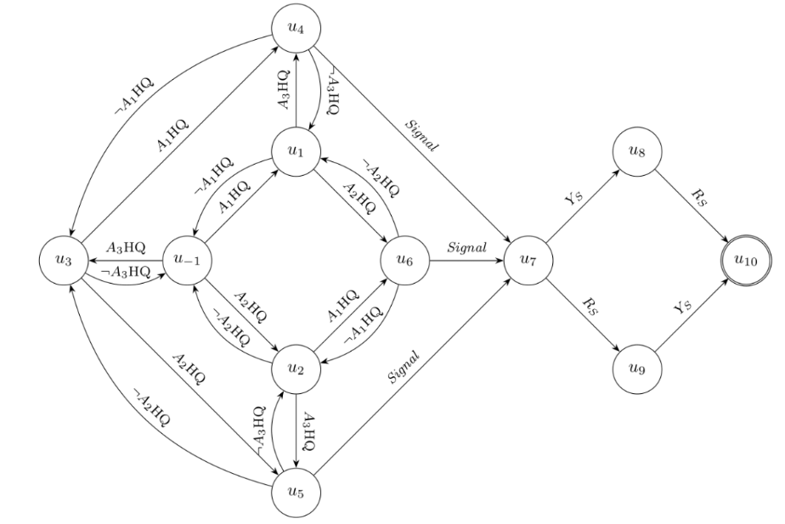
Problem Setting
Repairs domain
A task completion reward machine

Slide 9

Motivation
There are multiple possible decomposition
Agent 1 and Agent 2 meet at HQ
Agent 2 visits Rs
Agent 3 visits Ys
Agent 2 and Agent 3 meet at HQ
Agent 1 visits Ys
Agent 1 visits Rs
Agent 1 and Agent 3 meet at HQ
Agent 2 visits Ys
Agent 3 visits Rs
…
knowing which decomposition of the overall task leads to the most efficient completion of the task largely depends on the dynamics environment.
Propose an approach to automatically find optimal decompositions of an overall task into sub-tasks for a team of agents.

Slide 10
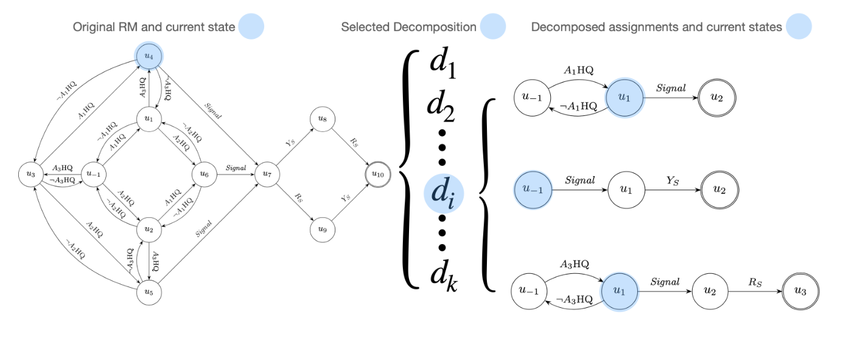
Methodology
Generating candidate decompositions
Original RM and current state
Selected Decomposition
Decomposed assignments and current states
‘top-𝑘’ valid candidate decompositions
Each decomposition is assigned a score based on :1) minimizing the average number of events assigned to each agent’s local event set; 2) maximizing the similarity amongst the sizes of all local event sets;

Slide 11
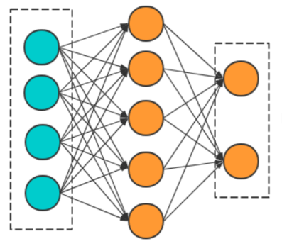
Methodology
Task-conditioned policies
Agent1
action1
Observation from the underlying MDP
Encoding of the selected decomposition
Agent1
action2
Current state in sub-task RM
…
…
Encoding of the current state in RM
Agentn
actionn
Task-conditioned policy
Each agent policy share a task-conditioned policy. We learn a single policy that outputs actions conditioned on a specific sub-task RM. We can then deploy separate copies of our policy on each agent during execution time.

Slide 12
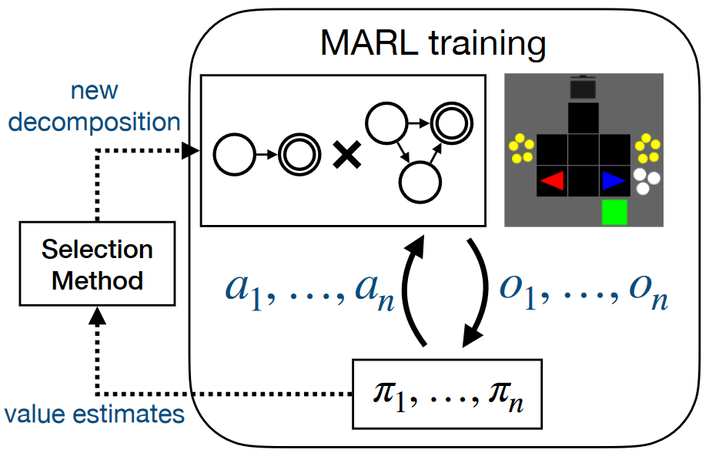
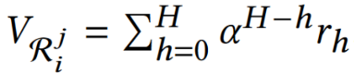
Methodology
Selecting decompositions during training
Upper Confidence Bound (UCB)

Slide 13
Experiment

Slide 14
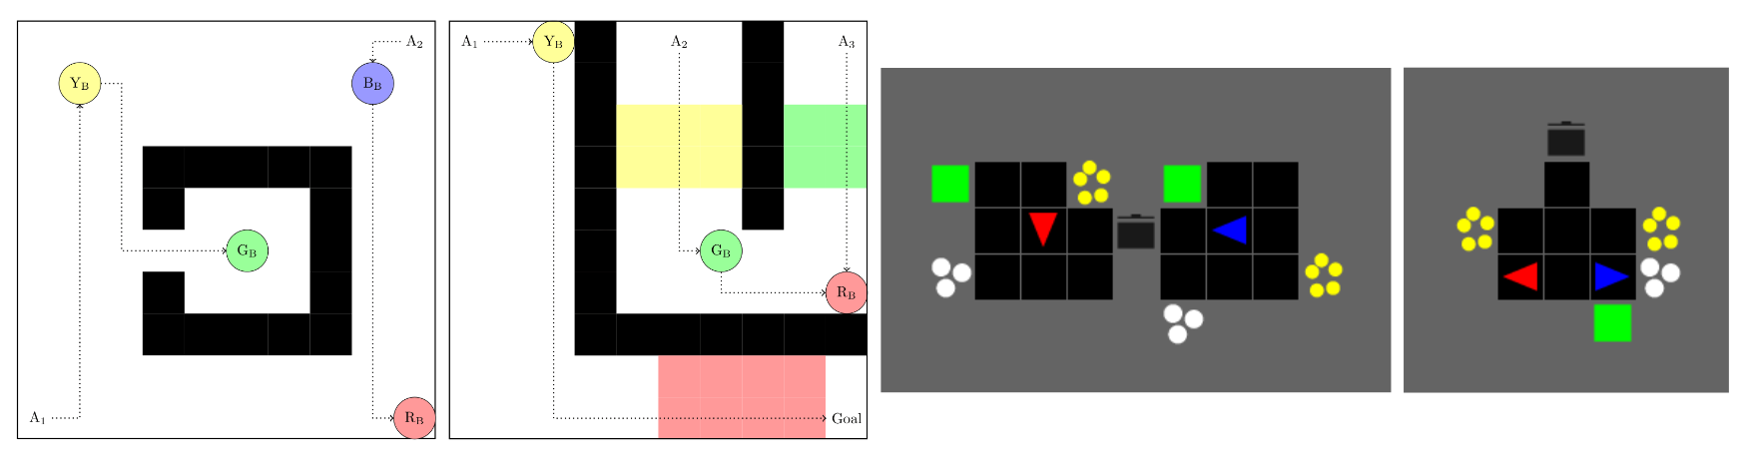
Experiment
Environments and baselines
Environments: Repairs, Cooperative Buttons, Four-Buttons, Cramped-Corridor and AsymmetricAdvantages
Baselines:
LOTaD: ours
ATAD: selects a set decomposition prior to learning based on the scoring method
Monolithic: evaluate how MARL would perform if no decomposition of the RM was used

Slide 15
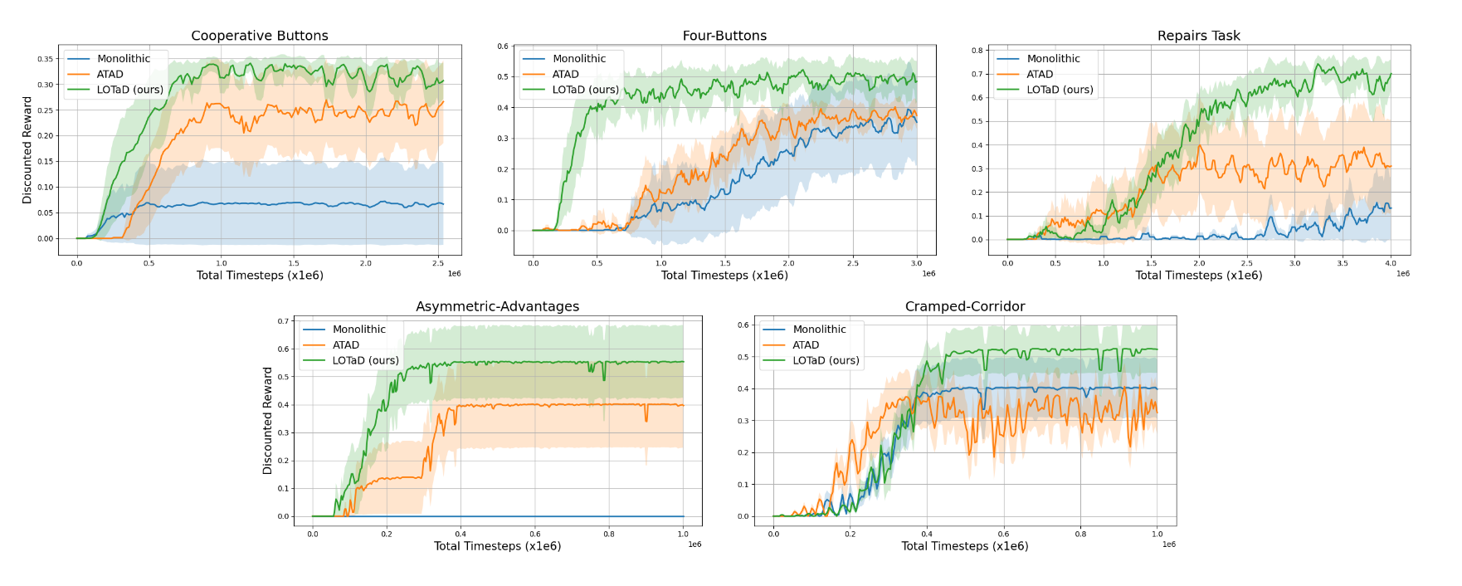
Experiment
Training curves for LOTaD and baseline methods in 5 experimental domains. Results are averaged over 5 random seeds.

Slide 16
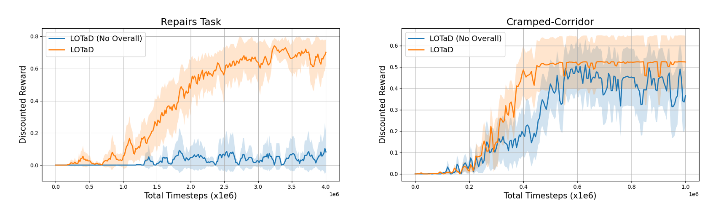
Experiment
Training curves for LOTaD in the Repairs Task and Cramped-Corridor environments demonstrating the effect of conditioning on the overall task state along with individual sub-task states for each agent.

Slide 17
Summary
Introduce a method for learning optimal decompositions from model-free interactions with the environment.
Provide a novel training architecture that allows multiple agents to train simultaneously within an environment and avoids conflicts that arise due to dependent dynamics across agents.
Demonstrate our approach’s improvement in learning multi-agent policies against baseline approaches in several cooperative environments

